Slide 1
Page Object Model

Slide 2
What is an Object Repository?
An object repository is a common storage location for all objects. In Selenium WebDriver context, objects would typically be the locators used to uniquely identify web elements.
Selenium WebDriver does not offer an in-built object repository by default. However, object repositories can be built using the key-value pair approach wherein the key refers to the name given to the object and value refers to the properties used to uniquely identify an object within the web page.

Slide 3
Types of Object Repositories in Selenium Web Driver
- Object Repository using Properties file
- Object Repository using XML file

Slide 4
Selenium Web Driver Object repository using Properties file
In this approach, properties file is a text file wherein data is stored on the form of key-value pairs. The below tutorial will address the following topics
Creating a properties file in eclipse
Storing data onto properties file
Reading data from properties file
Using properties file in test scripts

Slide 5
Selenium WebDriver Object Repository Using XML File
XML stands for Extensible Markup Language. An XML File uses Document Object Model(DOM) as the basic structure. XML File format will replicate the HTML format upon which the webpage is constructed. Below is the list of topics that will be covered.
Creating an XML file in eclipse
Storing data onto XML file
Reading data from XML file
Using XML file in test scripts

Slide 6
What is Page Object Model in Selenium?
Page Object Model, also known as POM, is a design pattern in Selenium that creates an object repository for storing all web elements. It is useful in reducing code duplication and improves test case maintenance.
In Page Object Model, consider each web page of an application as a class file. Each class file will contain only corresponding web page elements. Using these elements, testers can perform operations on the website under test.

Slide 7
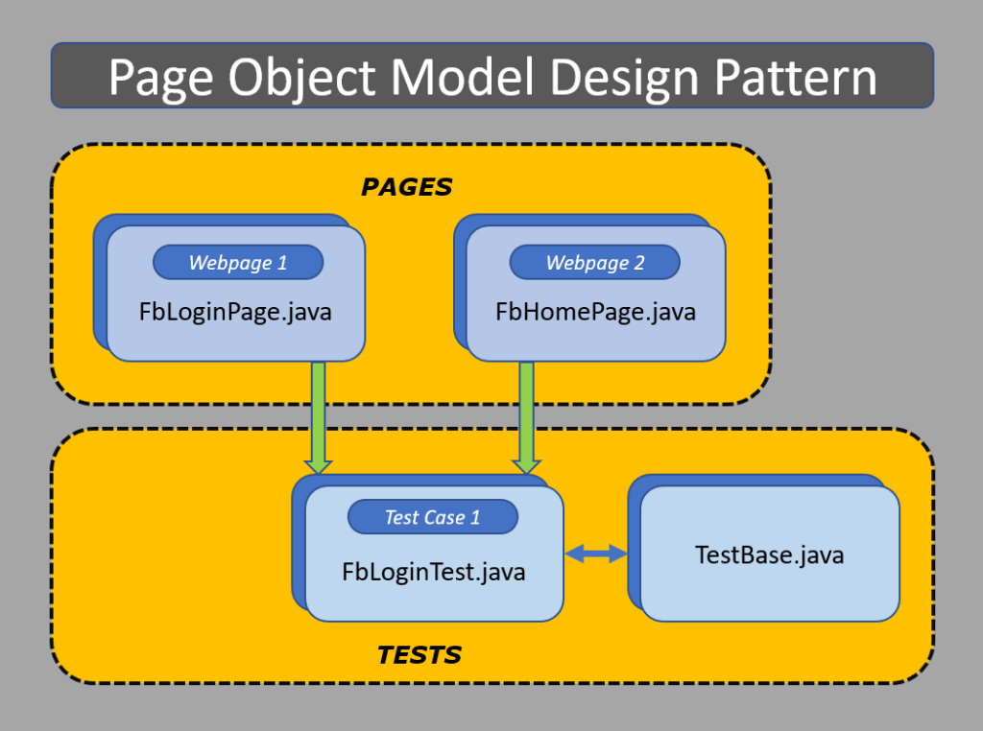

Slide 8
Steps To Be Follow For POM
Step 1: Create a class for each web page
Step 2 : Add object locators
Step 3: Create class for test
Step 4: Refer objects from page classes
Step 5:Run and validate

Slide 9
Benefits of POM
- Test Objects and Functions are separated for easy maintenance and keeping the code clean
- Objects are kept separated from test scripts and can be used
multiple times in multiple tests
- Every unique object locator is created only once
- Easy Maintenance and Less Rework

Slide 10
What is Page Factory in Selenium?
Page Factory in Selenium is an inbuilt Page Object Model framework concept for Selenium WebDriver but it is very optimized. It is used for initialization of Page objects or to instantiate the Page object itself. It is also used to initialize Page class elements without using "FindElement/s.“
@FindBy can accept tagName, partialLinkText, name, linkText, id, css, className, xpath as attributes.

Slide 11
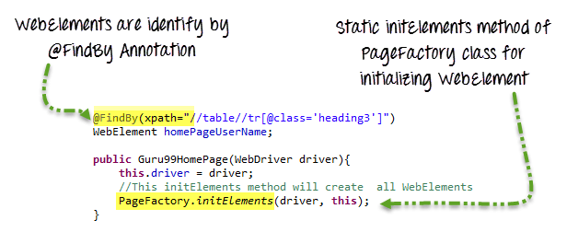
Note : Instead of this in we use class where our web elements are stored ie., PageFactory.initElements(driver, LoginPage.class)

